Slide 1

DESIGN AND DEVELOPMENT OF AN APPARATUS FOR DEMONSTRATING THE NATURAL FREQUENCY OF A VIBRATING SYSTEM.
a presentation by group 6

Slide 2
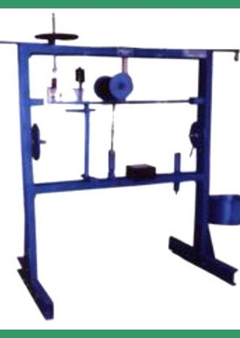
Agenda
3 | Introduction
5 | objectives
6 | methodology
8 | Result and discussion
10 | conclusion

Slide 3

INTRODUCTION
Natural frequency is defined as the frequency at which a body tends to vibrate when disturbed. It is an inherent property of the system, determined by its physical characteristics such as mass, stiffness, and geometry. At this natural frequency, the body vibrates at its maximum amplitude.

Slide 4
Problem statement
The university system is delving deeper into mechanical research work, and the natural frequency of a vibrating body is a fundamental parameter in the study of mechanical vibrations, hence an apparatus is needed.
Measuring the natural frequency of a material can be difficult because of the technique required to go about it. And if it is not done properly, it can have high variance from expected values.

Slide 5





objectives
one
two
three
four
five
Fabricate an apparatus that can measure natural frequency
Ensure the apparatus can withstand repeated use
Provide digital and graphical representation of stored values
Guarantee the apparatus educational value
Make sure the apparatus is versatile with lengths and thickness
YEAR 2025

Slide 6

methodology
Measuring natural Frequency

Slide 7
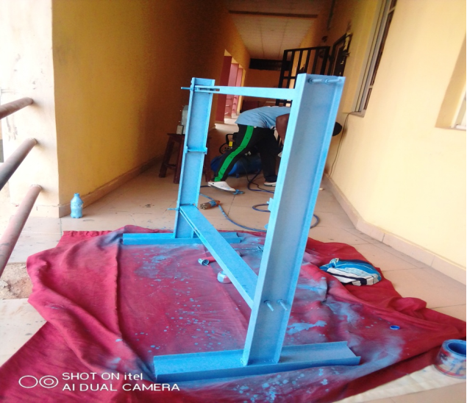
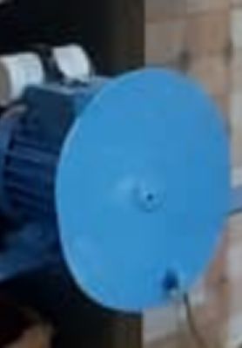

components
frame
Electric motor
Control box
Supports vibration load
Provides the vibration
Process the vibration

Slide 8
Result and discussion
Table 1: Raw data of the Natural Frequency obtained varying Length and Thickness
Length (mm) | Thickness (mm) | Experimental frequency (hz) | Calculated frequency (hz)
1200 | 3.7 | 50.3 | 52.4
1000 | 3.7 | 74.9 | 77.2
800 | 3.7 | 119.2 | 120.3
1200 | 7.8 | 110.1 | 112.8
1000 | 7.8 | 161.1 | 162.5
800 | 7.8 | 249.8 | 252.9
Material: mild steel Temperature: 296K Beam type: Simply supported

Slide 9
Graphical representation

Slide 10
conclusion
The project achieved the production of an apparatus that measures natural frequency, and provided valuable insights into the factors influencing natural frequency, with practical applications in various engineering fields.
The inherent nature of natural frequency and its relationship with thickness and length. Natural frequency reduces with increasing length but increases with increasing thickness.

Slide 11

recommendations
Research questions
Study the effects of composite materials on natural frequency.
Study the effect of material shape configuration and structure modification.
Study the effect of environmental conditions on natural frequency.
Apparatus development
Developing higher sensitivity sensors that do not need to be loaded on the material being tested
Integrate the versatility of testing various beam types.

Slide 12

THANK YOU
Group 6: ogbonna, ihenacho, adah, alali-michael, okeke, agba, ujaga.
Pc: engr. Dr. Cordelia omoyi
Mechanical engineering

